Slide 1
Tracing the Origins of
Hindu Dharma
Krishna Maheshwari
Founder, Hindupedia.com

Slide 2
Know your past
The past and present are the keys to the future
The past is the core of your roots and who you are
The past in our case, resolves present day confusion

Slide 3
Veda through the ages
The knowledge contained in the Veda are eternal
They were heard by the Rishi’s multiple times over multiple ages
Passed through an oral tradition
Eventually written down
Had significant portions destroyed
Had insertions with intention to distort
Received by us today

Slide 4
Raise your hand if
You have heard of Aryans & Dravidians
You know what the theory states
Believe in the theory
Have not read about how the theory has evolved over the past 20 years
Notes:
A quick check to baseline the audiance

Slide 5
Today’s Aim
Key Axioms
The Veda present the earliest traceable evidence of our civilization
There is an unbroken tradition linking Vedic times with today
Objective
Trace our heritage to a definitive “founding” date
Methodology
Multi-faceted approach leveraging
  Comparative analysis of religions & civilizations
  Sciences: Acheology, Archeo-astronomy
  Technology
  Scripture and scriptural development

Slide 6
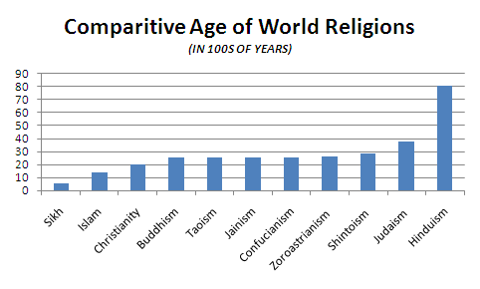
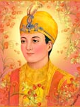
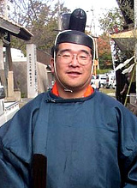

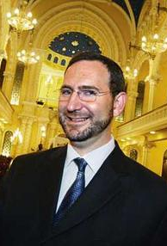


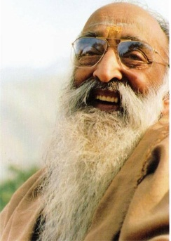
Comparing Religions
If 100 years = 1 religion year than
Sikhism: 5
Islam: 14
Christianity: 20
Buddhism, Taoism, Jainism and Confucianism: 25
Zoroastrianism: 26
Shintoism: late 20s
Judaism: 37
Hinduism: is 80+
Notes:
http://www.hindupedia.com/en/Origins
Flood myths
Similarities in other aspects, stories, knowledge
We expect (atleast until after the development (and reaching of maturity) of the other religions) that there will be a one-way transfer of knowledge/stories/etc (from Hindu dharma to the others)
eighty years old—the white-bearded grandfather of living spirituality on this planet

Slide 7
Comparing Civilizations
Sumerian
Harappan
Aegean
Egyptian
Harappa had limited exchange with Europeans
European
Indian
Notes:
We can see indus impact on other civilizations at their origins, but not vice versa until much later when they are more developed.

Slide 8
Archeological Basis

Slide 9
References to Saraswati Today
Daily Prayer
Ganga Cha Yamuna Chaiva Godavari Saraswati, Narmada Sindhu Kaveri Jalesmin Sannidhim Kuru
Kumba Mela
Triveni Sangam
  Ganga
  Yamuna
  Saraswati

Slide 10
Saraswati in Shastra
Rig Veda
Mentioned 60+ times
A “mighty river flowing from the mountains to the sea”
Mahabharata
Seasonal river
Disappeared in the desert
Reappears in some places
Joins the sea "impetuously"

Slide 11
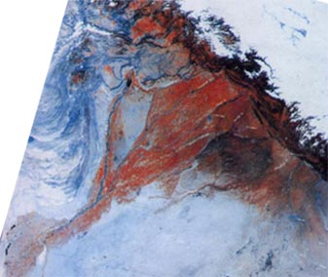
The Saraswati River was Real
More than 7 km wide at its widest point at its peak
Stopped going to the sea from the Himalayas between 6000-4000 BC
Completely dry by 1900 BC
Notes:
http://www.stephen-knapp.com/recent_research_on_the_sarasvati_river.htm
http://www.gisdevelopment.net/application/archaeology/site/archs0001.htm
http://sanskrit.safire.com/pdf/ORIGINS.PDF
http://www.eshiusa.org/Articles/Saraswati%20in%20Hindu%20Civilizational%20History%20and%20Culture.pdf
http://www.archaeologyonline.net/artifacts/vedic-civilzation.html
http://www.ias.ac.in/currsci/oct25/articles20.htm
Largest of 7 major river systems mentioned in Vedas
"Ganga Cha Yamuna Chaiva Godavari Saraswati,
Narmada Sindhu Kaveri Jalesmin Sannidhim Kuru"
Meaning: The literal meaning of this mantra is: "In this water, I invoke the presence of divine waters from the rivers Ganga, Yamuna, Godavari, Saraswati, Narmada, Sindhu and Kaveri. These rivers are considered as goddesses and I pray to them for considering me for their blessings.
Rig veda describes it as one of seven major rivers of Vedic times, the others being, Shatadru (Sutlej), Vipasa (Beas), Askini (Chenab), Parsoni or Airavati (Ravi), Vitasta (Jhelum) and Sindhu (Indus)

Slide 12
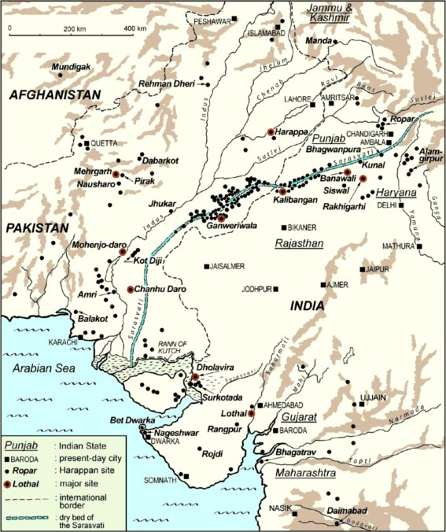
Harappan Civilization
Largely aligned to the Saraswati River
Approximately 2,600 sites covering over 500,000 sq miles (identified so far)
  Modern India covers 1.2M sq miles
Notes:
http://micheldanino.voiceofdharma.com/indus.html

Slide 13
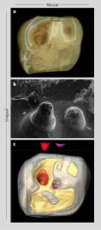
Early Mehrgarh
Early Harrapan city
Continuous usage for 4,500 years
People lived in mud-based 4-room houses
Occupations
  Farming
  Animal husbandry
  Dentistry
  Molars with cavities removed
Notes:
Odd that a city dated 7000BC has dentistry. Considering how painful it is, can we suppose some form of anesthesia? Especially considering that the people who had dentistry performed in their molars lived afterwards…

Slide 14
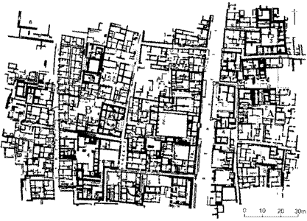
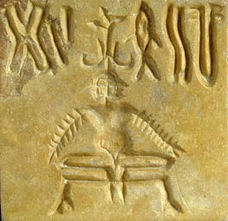
Harappan Civilization
Planned Cities
  North-South streets
  Typically west of a river
  Followed Stapatya Veda
Houses according to Vastu
  Doors faced East
  Bathrooms and a kitchen
  Under-street sewers
Water conservation using check-dams
Yoga
Notes:
Sthapatya Veda describes these rules for city building (basis for vastu shastra)
http://reference.indianetzone.com/1/town_planning.htm

Slide 15
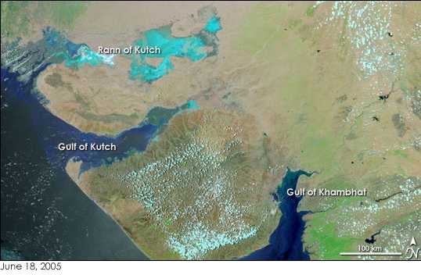
Gulf of Khambhat findings
Estimates place city around 11,000 BC
5 miles x 2 miles
Human presence as far back as 29,000 BC
Notes:
http://timesofindia.indiatimes.com/cms.dll/html/uncomp/articleshow?msid=782649
That is a pretty large walled city to have that long ago.
http://www.archaeologyonline.net/artifacts/cambay.html
Pottery shards, etc dated to these dates
29,000 – ie during the ice age

Slide 16
Astronomical Basis

Slide 17
Key Terms & Definitions
Equinox
Point in the year when day and night time are equal (12 hrs each)
Tropical Year
Time for the sun to return to the same position in the cycle of seasons i.e., the time between equinoxes
Precession
Wobble of a earth as it spins about its axis
Proper Motion
Movement of a star across the night sky relative to other stars in its vicinity
Perihelion
Point of closest approach between the Earth and the Sun

Slide 18
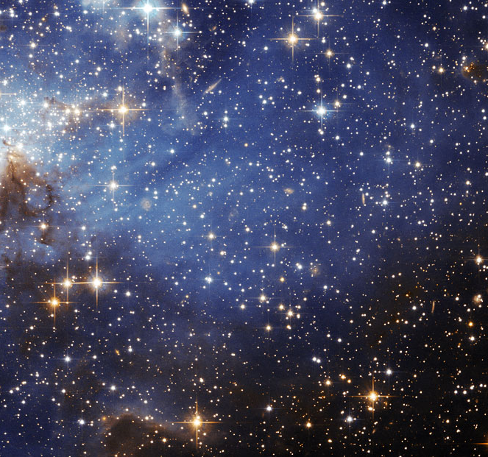
Assumptions
Naked eye observations accurate to 1/6°
Continuous observation over multiple lifetimes
Multi-generational record keeping
Notes:
We don’t have any evidence of telescopes until much later (jantar mantar, etc)
Assume Rishi’s didn’t get any insight through samadhi, etc for the moment

Slide 19
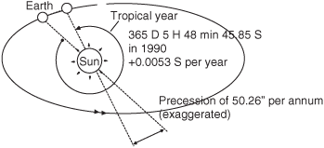
Tropical Year
Tropical year: Interval between two equinoxes
“Solar Year”
Suryasiddhanta: 365.2435374 days
Modern Science: 365.2421897 days (in 2000)
Difference: 1 min, 54.44128 seconds
Observe time required: 10,000 years
Notes:
The tropical period of the Sun changes over time…ie the Surya Siddhantha could have been 100% accurate at the time it was written. We have not calculated the period of the tropical year in the ancient past.
If 100% accurate, Suryasiddhanta could be dated to 21,592 years ago or 19,592 BC.
http://scienceworld.wolfram.com/astronomy/TropicalYear.html
Image source: http://content.answcdn.com/main/content/img/McGrawHill/Aviation/f0663-02.gif

Slide 20
Measuring Earth’s Precession
Precession
Proper Motion
Perihelion
Tropical Year
Surya Siddhanta:0.014°
Year 1900: 0.013958°
3,600 years of observation
1000 years to observe Sirius move 1/6°
Requires over 10,000 years of unaided observation to for this level of precision
Notes:
Perihelion: point where earth is closest to the sun
Proper motion of stars: how the stars travel through the night sky
Precision of Equinoxes: equinox is when the earth is tilted towards/away from the sun maximally. Precision of equinoxes refers to where this happens changes over a period of time
Equinoxes: Difference from modern calculations
Image source: http://earthobservatory.nasa.gov/Features/Milankovitch/milankovitch_2.php
Image source: http://www.imsc.res.in/~rahul/articles/calendar.html
http://www.daviddarling.info/images/perihelion_advance.jpg
http://religionnerd.net/wp-content/uploads/2010/03/vernal-equinox12.jpg
http://upload.wikimedia.org/wikipedia/commons/9/90/Sirius_proper_motion.gif
http://www.hindupedia.com/en/Astronomy
http://www.new.dli.ernet.in/rawdataupload/upload/insa/INSA_1/20005b5d_183.pdf

Slide 21
Dating the Surya Siddhanta
 | Common Dating | Accuracy of Data
Assumptions | Authorship in 300 AD based on linguistics Naked eye observations | 100% accurate data Aided observations
Implications | 10,000 BC as start of observation period Records passed down from astronomer to astronomer over 10,000 years | 19,592 BC as dating of events mentioned in text
Notes:
The Surya Siddhanta (in the 23rd verse of the 1st chapter) dates itself as having been given by Lord Surya at the end of krita yuga. The preceding verse says that Suryasiddhanta was given to sages in previous yugas too, ie in previous krita yugas.

Slide 22
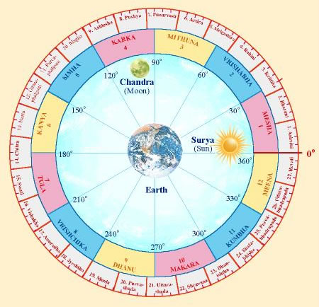
Astronomy Basics : Nakshatra
25,675 year cycle of 27 nakshatras
Each nakshatra lasts 955 Years
Dependent on the location of the earth relative to the Sun & stars

Slide 23
Astronomy in the Veda
 | Observance | Last Occurrence
Rig Veda | Winter equinox in Ashwini | 7,000 BC
 | Revati at the winter solstice | 6,000 BC
 | Vernal Equinox in Punarvasu | 5,000-6,000BC
 | Vernal equinox in Mrigashira | 5,000 BC
Yajur Veda | Purvabhadrapada nakshatra as rising due east | 10,000 BC
 | Krittika at the winter solstice | 8,500 BC
Notes:
http://sanskrit.safire.com/pdf/ORIGINS.PDF
http://www.vedah.com/org/literature/rigVeda/wrrv/date.asp
http://www.vedah.com/essays-on-veda-upanishad-etc/elementary-topics/50-why-read-rig-veda/338-date-of-the-rigveda
http://books.google.com/books?id=DM58BhuR2KwC&pg=PA185&lpg=PA185&dq=vernal+equinox+in+the+rig+veda&source=bl&ots=CB1_IrpLtn&sig=F9p-px5NAih4gM2V1rnVTcb-qqw&hl=en&ei=E2d9TL7CBoL58AaJ1pmZCA&sa=X&oi=book_result&ct=result&resnum=8&ved=0CDAQ6AEwBw#v=onepage&q=vernal%20equinox%20in%20the%20rig%20veda&f=false
Gods, Sages and Kings: Vedic Secrets of Ancient Civilization By David Frawley

Slide 24
Astronomical Dating Problems
Dating Vernal equinox in Mrigashira
Inner Limit: | (N x 25,675)+7,634
Outer Limit: | (N x 25,675)+9,542
where N >= 0
All astronomical signs repeat
Need a non-astronomical point of reference to limit “N”

Slide 25
Ramayana
Rama
Hanuman
Jamvant
Dating much more uncertain
Contains lots of astronomical details
Self dates to Treta Yuga
Valmiki referred to in the Yajurveda
Does not discuss the Saraswati River
Notes:
Dvapara-Yuga: 864,000 (http://www.hindupedia.com/en/Astronomy)
Thus Treta yuga ended roughly .8M years ago (Kali began ~3000 BC) and lasted 1,296,000 years. If we look at treta yuga properly (which is when the ramayana took place), than that is roughly 1M years ago.
Rama picture: http://1.bp.blogspot.com/_g4zJ-O_EKdQ/Szocr-dp_vI/AAAAAAAAAwg/ZRnjcObNduA/s320/Bhagwan+Rama.jpg
Hanuman picture:http://srirammandirdwarka.org/yahoo_site_admin/assets/images/lord-hanuman_2.229221900.jpg
Jamvant picture: http://i46.tinypic.com/eumplc.jpg
Valmiki referred to in the Taittiriya Brahmana in the Yajurveda

Slide 26
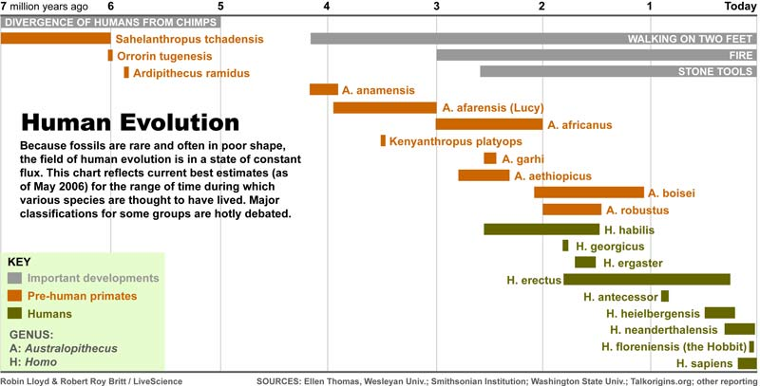
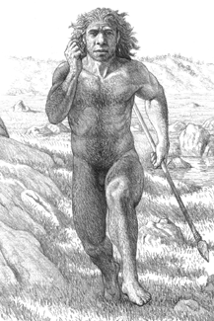
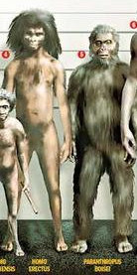
Ramayana?
Notes:
Lets speculate for a moment…

Slide 27
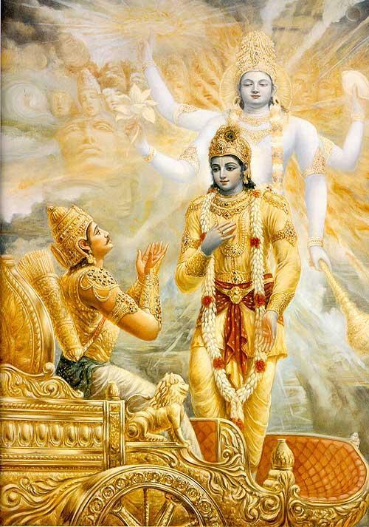
Mahabharata
Possible co-incidence with archeological evidence
140 astronomical references
Discovery of submerged Dwarka off the coast of Dwarka
  Containing a seal mentioned in the Mahabharata
  Apparently on land reclaimed from the sea
Refers to Saraswati as a seasonal river
Dating no later than 1900 BC
Typically dated to approx. 5500 BC
Notes:
http://www.hindunet.org/hindu_history/ancient/mahabharat/mahab_vartak.html
Bet Dwarka is one of 6/7 Dwarka’s that got flooded. We have yet to discover the others…so don’t know if that is Lord Krishna’s city or not.
Dating is based on astronomical occurrences that happened within the defined date range of 5500 BC and 1100BC…no one has thought to look at older occurrences…

Slide 28
Scientific & Technological Basis
A Sampling from Shastra

Slide 29
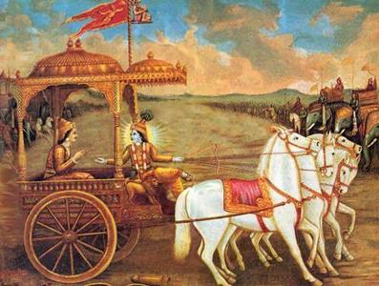
What is a Ratha?
Common depiction of Arjuna’s Ratha from Mahabharata

Slide 30

What is a Ratha?
Ferrari or Vidyut Ratha?

Slide 31
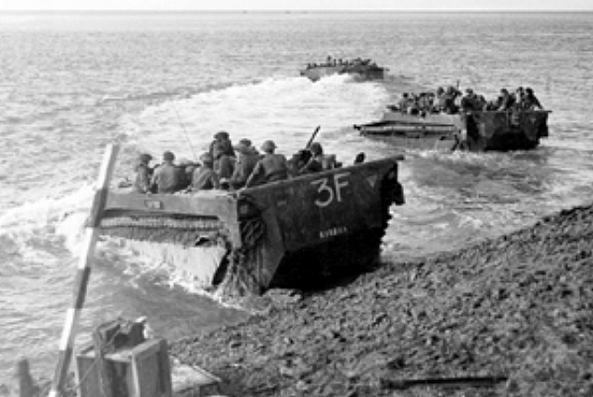

Rigvedic Vehicles
Kaara Ratha
Jalayan | An amphibian aircraft
Kaara | An amphibious vehicle
Tritala | a three storied vehicle
Trichakra | a three-wheeled flying vehicle
Vaayu | a gas or wind-powered vehicle
Vidyut | a powered vehicle
Trichakra Ratha
Notes:
Rig Veda 6.58.3: Jalayan
Rig Veda 9.14.1: Kaara-Kaara…
Rig Veda 3.14.1: Tritala…
Rig Veda 4.36.1: Trichakra Ratha
Rig Veda 5.41.6: Vaayu Ratha
Rig Veda 3.14.1: Vidyut Ratha
Aitareya brahmana 3.44 (Rig Veda): Sun rise/etc
Image: http://files.myopera.com/Weatherlawyer/albums/643041/Solar%20System.jpg

Slide 32
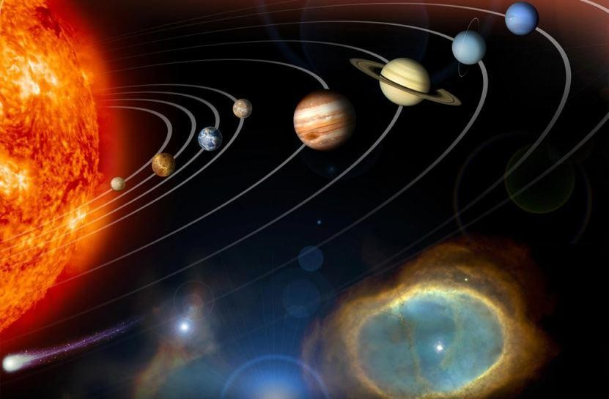
Rigveda
Earth being round and in solar orbit
“The Sun does never set nor rise. When people think the Sun is setting it is not so.
For after having arrived at the end of the day it makes itself produce two opposite effects, making night to what is below and day to what is on the other side…
Having reached the end of the night, it makes itself produce two opposite effects, making day to what is below and night to what is on the other side. In fact, the Sun never sets….”
--Aitareya brahmana 3.44
Error Correcting Codes & Encryption
Notes:
Rig Veda 6.58.3: Jalayan
Rig Veda 9.14.1: Kaara-Kaara…
Rig Veda 3.14.1: Tritala…
Rig Veda 4.36.1: Trichakra Ratha
Rig Veda 5.41.6: Vaayu Ratha
Rig Veda 3.14.1: Vidyut Ratha
Aitareya brahmana 3.44 (Rig Veda): Sun rise/etc
Image: http://files.myopera.com/Weatherlawyer/albums/643041/Solar%20System.jpg

Slide 33
Sample of Science in the Puranas
Multiple types of Viman-s, their construction, etc
Concept of stars with each being like the Sun
Speed of light at 186,000 miles / hour
Age of the earth at more than 4 billion years
Relativity of Time
Impact of the moon’s phases on tides
Instructions on how to make an electrical battery
How to split water into Hydrogen & Oxygen
Notes:
http://hinduwisdom.info/Advanced_Concepts.htm

Slide 34
Mahabharata War: Agneya Astra
A blazing shaft possessed of the effulgence of a smokeless fire, and let it off on all sides,…Endued with fiery flames…Meteors flashed down…A thick gloom suddenly shrouded the (Pandava) host.
All the points of the compass also were enveloped by that darkness...Inauspicious winds began to blow. The sun himself no longer gave any heat…
The universe, scorched with heat, seemed to be in a fever…The very waters heated, the creatures residing in that element…seemed to burn.
From all the points of the compass, … from the firmament and the very earth, showers of sharp and fierce arrows fell and issued with the impetuosity of the wind…the hostile warriors fell down like trees burnt down by a raging fire.
Huge elephants, burnt by that weapon, fell down on the earth all around, uttering fierce cries loud as the rumblings of the clouds…
The steeds, O king, and the cars also, burnt by the energy of that weapon, looked, O sire, like the tops of trees burnt in a forest-fire. Thousands of cars fell down on all sides. Indeed, O Bharata, it seemed that the divine Lord Agni burnt the (Pandava) host in that battle, like the Samvarta fire consuming everything at the end of the Yuga…
Burnt by the energy of Aswatthaman's weapon, the forms of the slain could not be distinguished…a full Akshauhini [218,700] of the Pandava troops killed
Source: Translation of Mahabharata into English published 1883 to 1896 by Kisari Mohan Ganguli (1842-1895) [Mahabharata, Drona Parva, CCI]
Notes:
Mahabharata, Drona Parva, CCI (Agneya)
Translation of Mahabharata into English published 1883 to 1896 by Kisari Mohan Ganguli (1842-1895)
Agneya:
The valiant Aswatthaman,
then, staying resolutely on his car, touched water and invoked the Agneya
weapon incapable of being resisted by the very gods. Aiming at all his
visible and invisible foes, the preceptor's son, that slayer of hostile
heroes, inspired with mantras a blazing shaft possessed of the effulgence
of a smokeless fire, and let it off on all sides, filled with rage. Dense
showers of arrows then issued from it in the welkin. Endued with fiery
flames, those arrows encompassed Partha on all sides. Meteors flashed
down from the firmament. A thick gloom suddenly shrouded the (Pandava)
host. All the points of the compass also were enveloped by that darkness.
Rakshasas and Pisachas, crowding together, uttered fierce cries.
Inauspicious winds began to blow. The sun himself no longer gave any
heat. Ravens fiercely croaked on all sides. Clouds roared in the welkin,
showering blood. Birds and beasts and kine, and Munis of high vows and
souls under complete control, became exceedingly uneasy. The very
elements seemed to be perturbed. The sun seemed to turn. The universe,
scorched with heat, seemed to be in a fever. The elephants and other
creatures of the land, scorched by the energy of that weapon, ran in
fright, breathing heavily and desirous of protection against that
terrible force. The very waters heated, the creatures residing in that
element, O Bharata, became exceedingly uneasy and seemed to burn. From
all the points of the compass, cardinal and subsidiary, from the
firmament and the very earth, showers of sharp and fierce arrows fell and
issued with the impetuosity of Garuda or the wind. Struck and burnt by
those shafts of Aswatthaman that were all endued with the impetuosity of
the thunder, the hostile warriors fell down like trees burnt down by a
raging fire. Huge elephants, burnt by that weapon, fell down on the earth
all around, uttering fierce cries loud as the rumblings of the clouds.
Other huge elephants, scorched by that fire, ran hither and thither, and
roared aloud in fear, as if in the midst of a forest conflagration. The
steeds, O king, and the cars also, burnt by the energy of that weapon,
looked, O sire, like the tops of trees burnt in a forest-fire. Thousands
of cars fell down on all sides. Indeed, O Bharata, it seemed that the
divine lord Agni burnt the (Pandava) host in that battle, like the
Samvarta fire consuming everything at the end of the Yuga.
Then Arjuna, O king, invoked into
existence the Brahma weapon, capable of baffling every other weapon, as
ordained by the Lotus-born (Brahma) himself. Within a moment that
darkness was dispelled, cool winds began to blow, and all the points of
the compass became clear and bright.
We then beheld a wonderful sight,
a full Akshauhini (of the Pandava troops) laid low. Burnt by the
energy of Aswatthaman's weapon, the forms of the slain could not be
distinguished.
Then those two heroic and mighty bowmen, viz., Kesava and
Arjuna, freed from that darkness, were seen together, like the sun and
the moon in the firmament.
Indeed, the wielder of Gandiva and Kesava were
both unwounded. Equipped with its banners and standards and steeds, with
the Anukarsa unjoined; and with all the mighty weapons stored on it
remaining uninjured, that car, so terrible to thy warriors, freed from
that darkness, shone resplendent on the field.

Slide 35
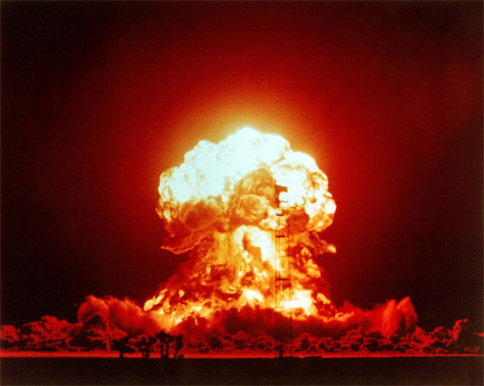
Death Toll
Agneya Astra
  218,700
Hiroshima
  60,000-80,000
Nagasaki
  90,000-166,000
Notes:
Image: http://www.allamericanpatriots.com/photos/mushroom-cloud

Slide 36
Scriptural Basis

Slide 37
Textual Development
Shastra as Siddhanta
  Siddha: the goal, the achievement - siddha
  Anta: is reached, or its end
  Final attainments or conclusions
Are the culmination of a long process of discussion, criticism and review
  Grammar (85 grammarians known before Panini)
  Vedanta (many generations of teachers)
Veda are direct in their statements
  Yet, speak in many tongues
  Requires solidified thought
  Communicated in a mature language
Whatever the origin date, need to add period for development of technology & thought
Notes:
Siva Senani Nori – email discussion
http://sanskrit.safire.com/pdf/ORIGINS.PDF
1900+ years to develop if assumed to be human thought

Slide 38
Scriptural References
The Surya Siddhanta
  Dates itself as having been given by Lord Surya at the end of krita yuga
  Also states that it was given to sages in previous yugas too
Many scriptures give similar dates
Notes:
Surya Siddhanta: in the 23rd verse of the 1st chapter

Slide 39
Limitations
Increasing compression of information over time
Perspective
  Idea centric vs event centric
  Event centric vs person centric
Not historical texts for the most part

Slide 40
Conclusion
Archeological View | 7,500 BC based on earliest finds
Astronomical View | 10,000 BC or change in assumptions
Technological View | At least 2,000 years prior to Rig Veda Doesn’t explain loss of technology of Mahabharata
Scriptural View | Much older…multiple presentations over multiple yugas Creates cognitive dissonance

Slide 41
Hindupedia.com
The online encyclopedia of Hindu Dharma

Slide 42
Hindupedia.com
First, online encyclopedia of Hindu Dharma
Wide range of topics
Mission to
  Provide college students and academics a base of knowledge
  Enable curriculum development
  Support curriculum change
  Give voice to the teachings enshrined in parampara
  Provide an internal perspective
2,788+ entries (today), 40,000+ monthly visitors

Slide 43
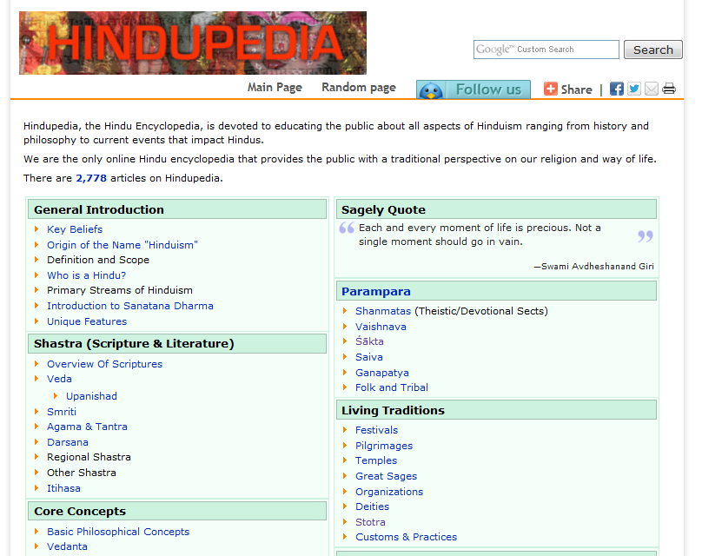

Slide 44
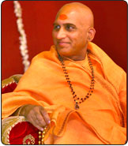
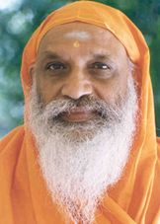



The Team
Advisory Board
Editorial Board
We are recruiting editors & researchers
2 researchers
30 content reviewers
2 online marketers
Several partnering publications
Notes:
Left to Right:
Swami Avdheshananda Giri – Head acharya, mahamandaleshvar of Juna Akahada, On Astha, Sanskar every day with his Bhagavad Katha, and the first person to bathe during the Kumbha Mela
Swami Dayananda Saraswati – founder of Acharya Sabha (and first attempt to unify all sects of our dharma)
Dr. David Frawley – reknowned jyothish and ayurvedic doctor. He is also the first westerner to get a title ‘Shastri’ from a reputed institute in India
Swamini Sadvidyananda Saraswati – expert Vedanta lecturer, desciple of Swami Dayanandaji.

Slide 45
Q&A

